Slide 1

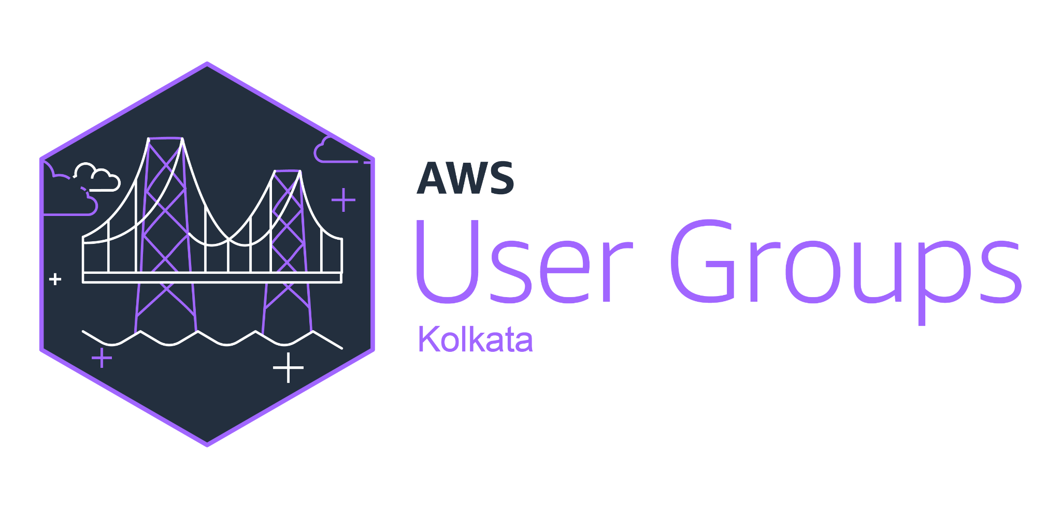

Agentic AI with Amazon Q Business
Biraj Bhushan Choudhury
Sr Product manager Hyland Software

Slide 2
Introduction
Amazon Q Business is a generative AI assistant that boosts employee productivity and transforms the way that you get work done. You can quickly find accurate answers from your enterprise content, backed up with citations and references. You can brainstorm new ideas, generate content, or create summaries using Amazon Q Business based on your enterprise data. Amazon Q Business ensures that users access enterprise content securely according to their permissions. You can quickly deploy Amazon Q Business with built-in connectors to popular enterprise repositories.

Slide 3
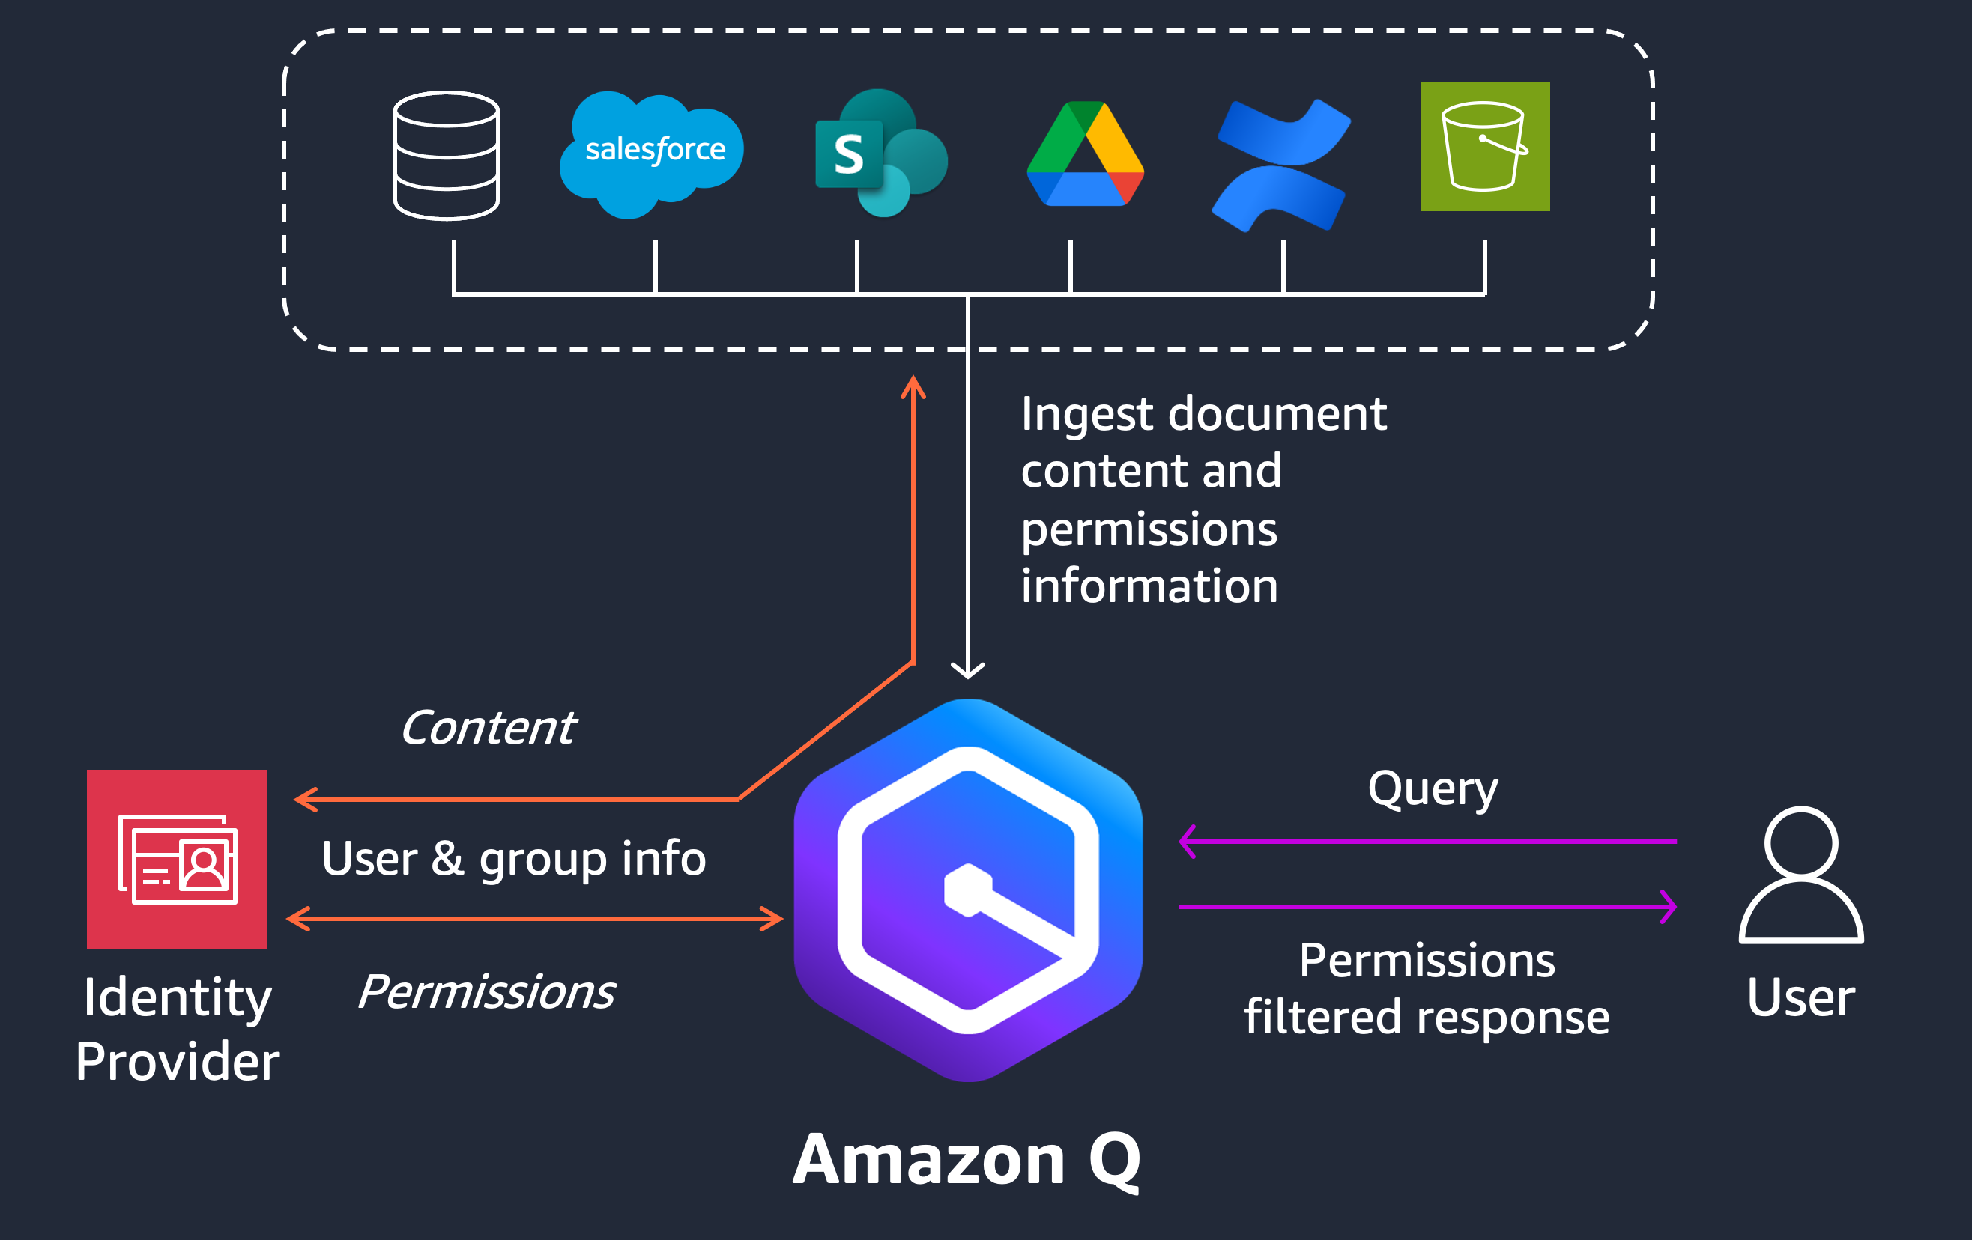
Introduction

Slide 4
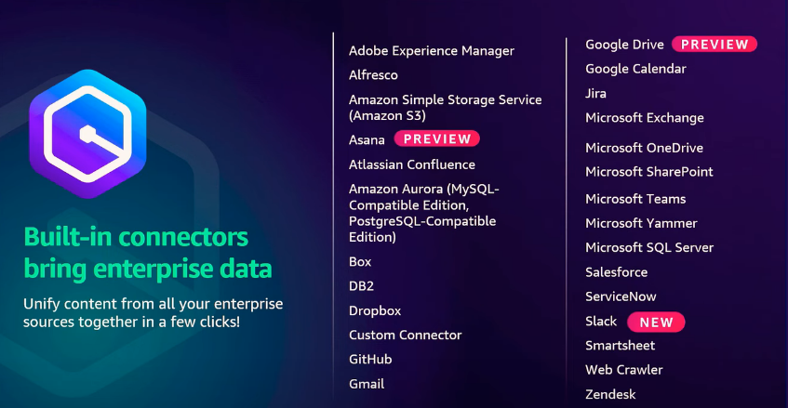
Connectors – Ingest Data

Slide 5
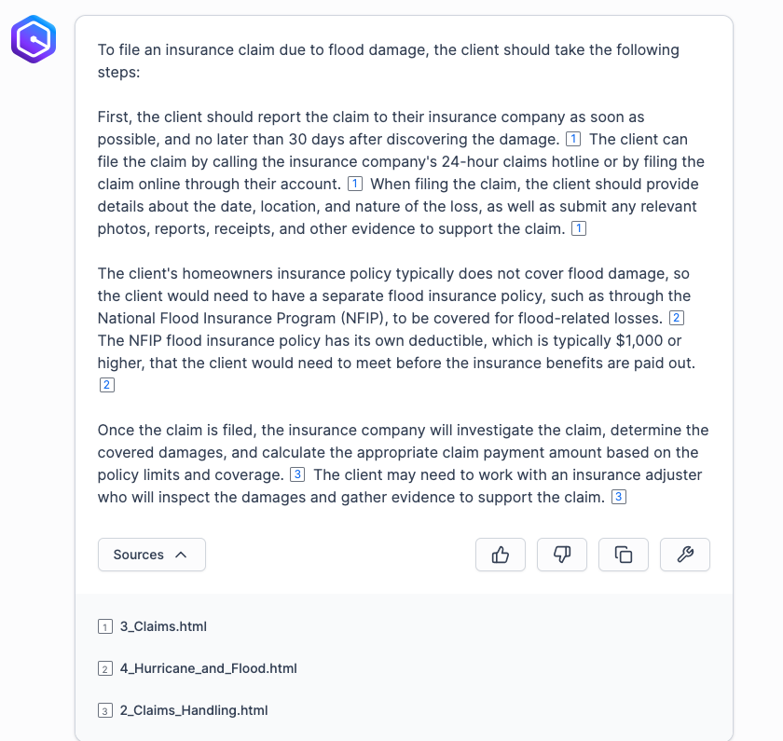
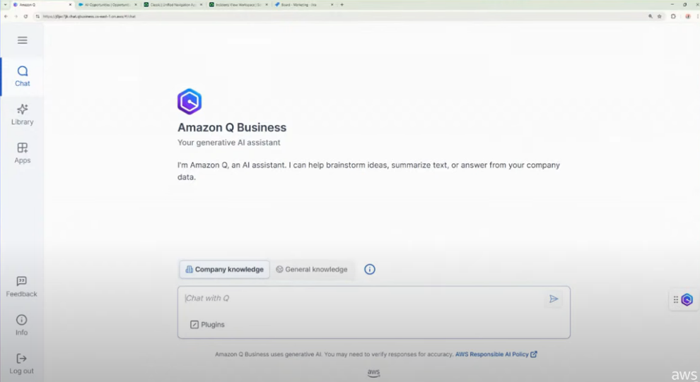
Derive Insights

Slide 6
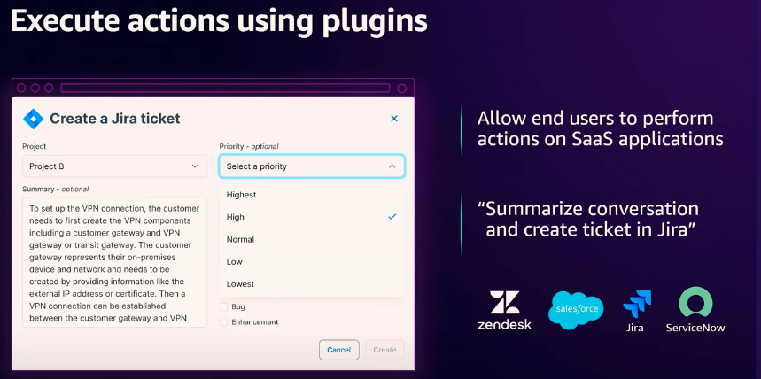
Plugins – Performing actions

Slide 7
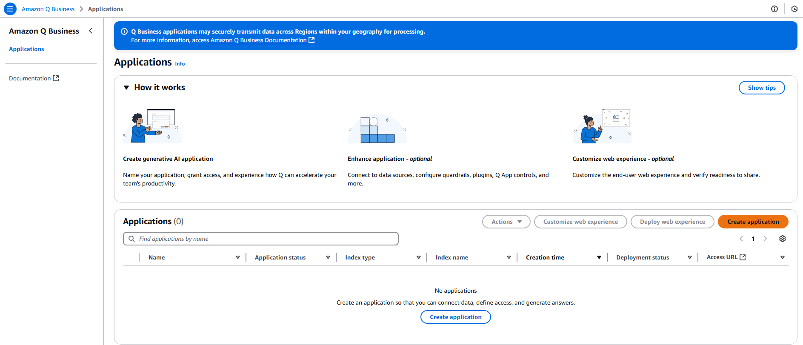
Create a AWS Q Business Application

Slide 8
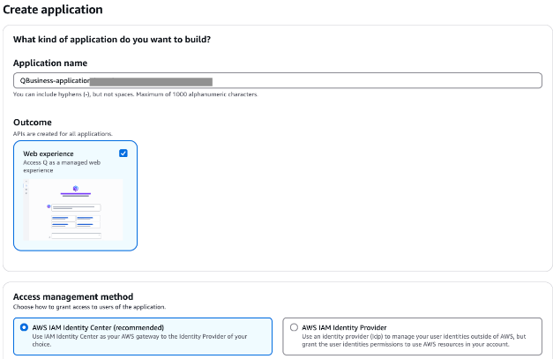
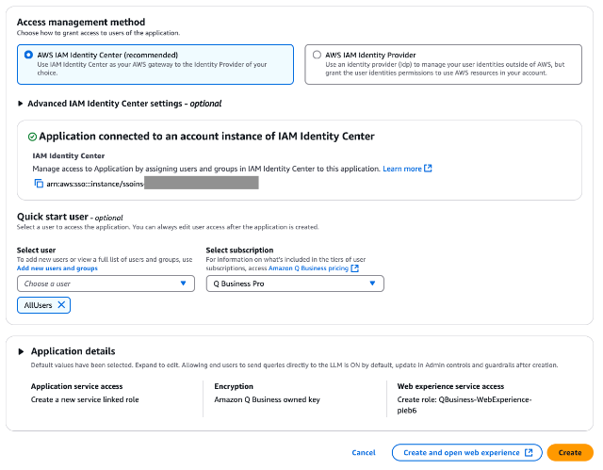
Access Management method And Service Roles

Slide 9
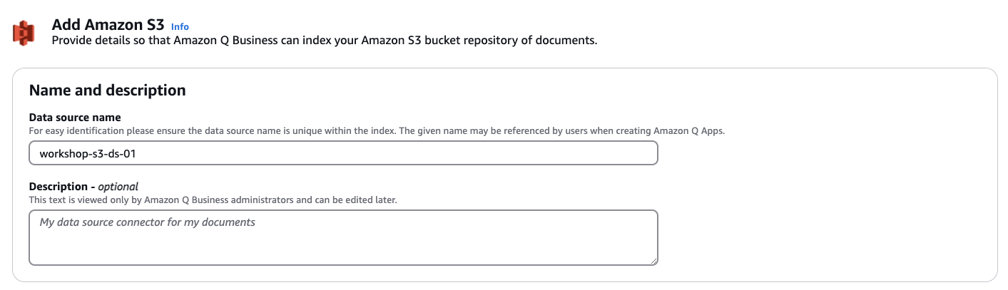
Add Data Sources

Slide 10
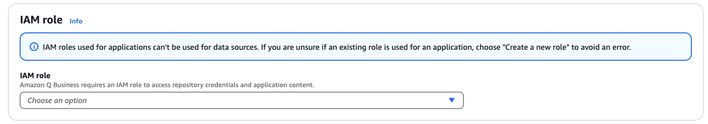
Create Service Role for the Data Source

Slide 11
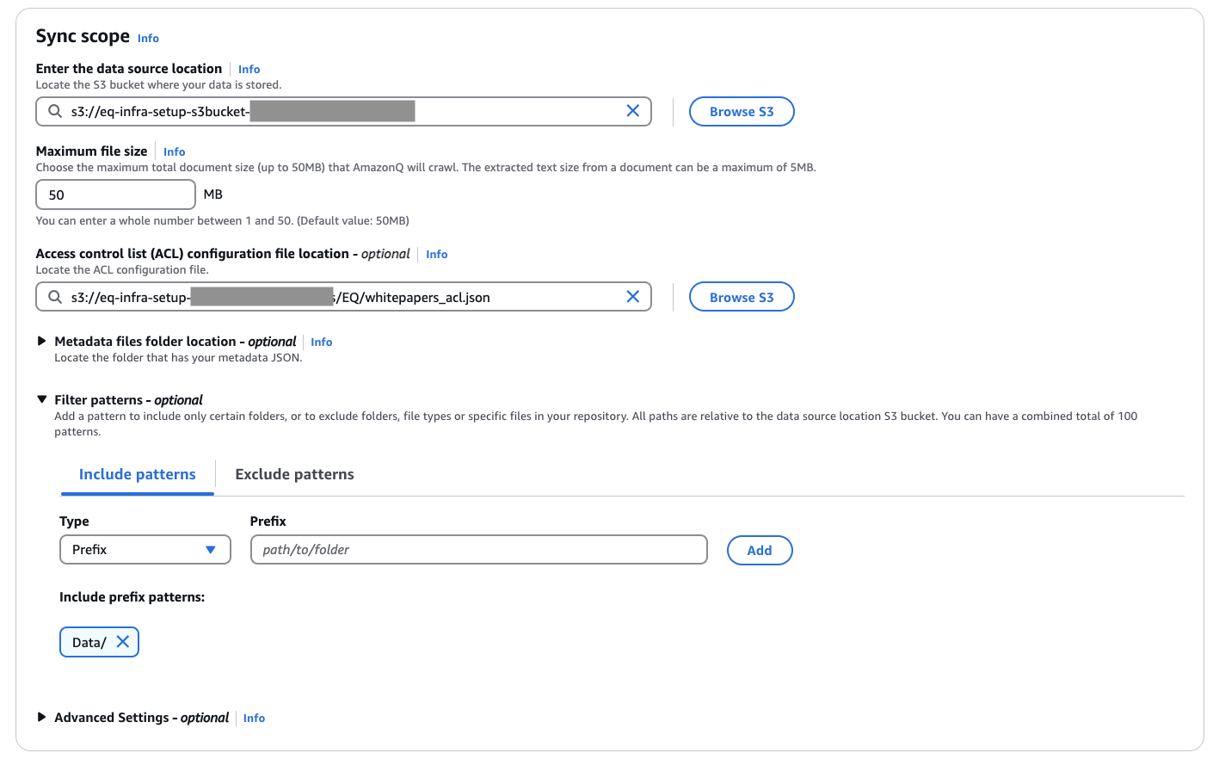
Point to the Data Source and Set Sync intervals

Slide 12
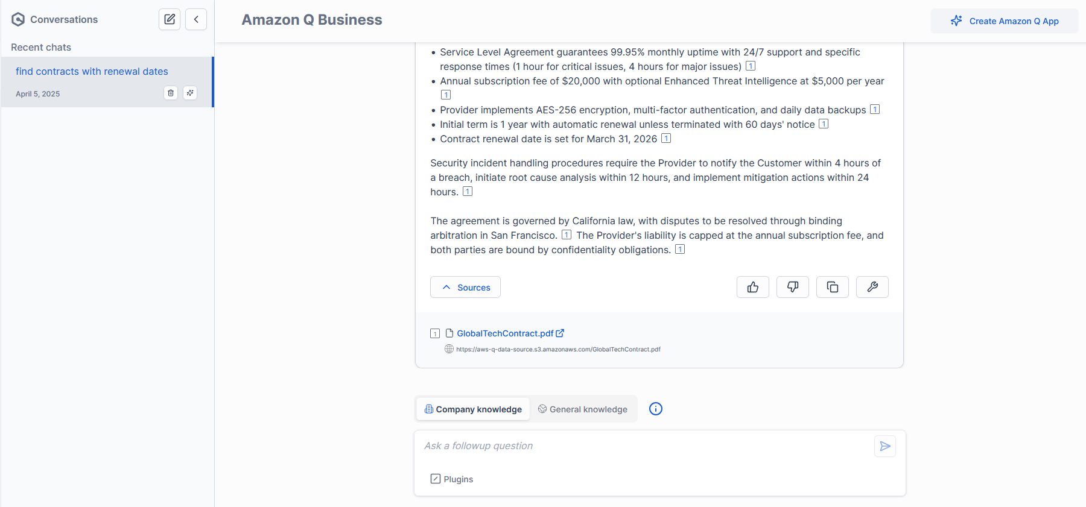
Access your AI Assistant

Slide 13
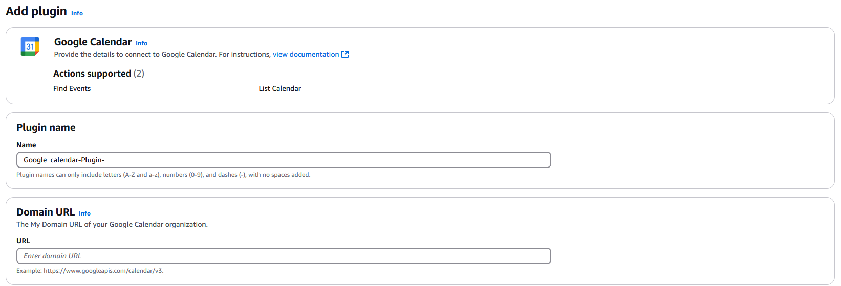
Add Calendar Plugin

Slide 14
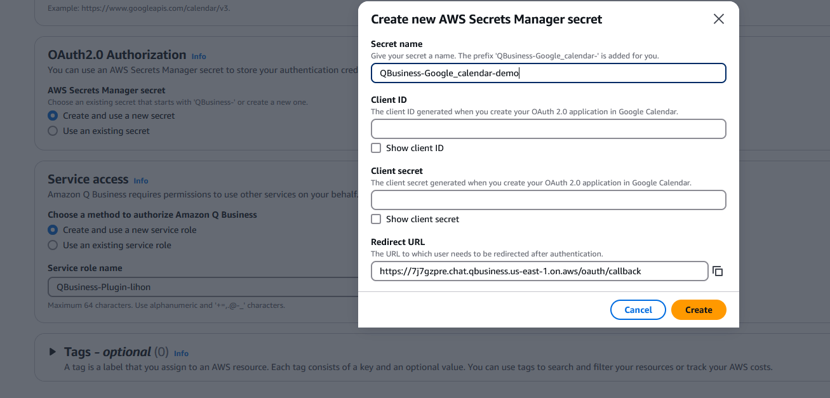
Add Google Calendar Plugin

Slide 15
Add Google Calendar Plugin
To obtain a Client ID and Client Secret for integrating Google Calendar with your application, follow these steps:
Access Google Cloud Console
Create a New Project
Enable Google Calendar API
Configure OAuth Consent Screen
Create OAuth Client ID:
Navigate to APIs & Services > Credentials.​
Click "Create Credentials" and select "OAuth client ID".​
Choose Application Type (e.g., Web application).​
Specify Authorized JavaScript origins and Authorized redirect URIs relevant to your application.​
Click "Create".​
Obtain Client ID and Client Secret

Slide 16
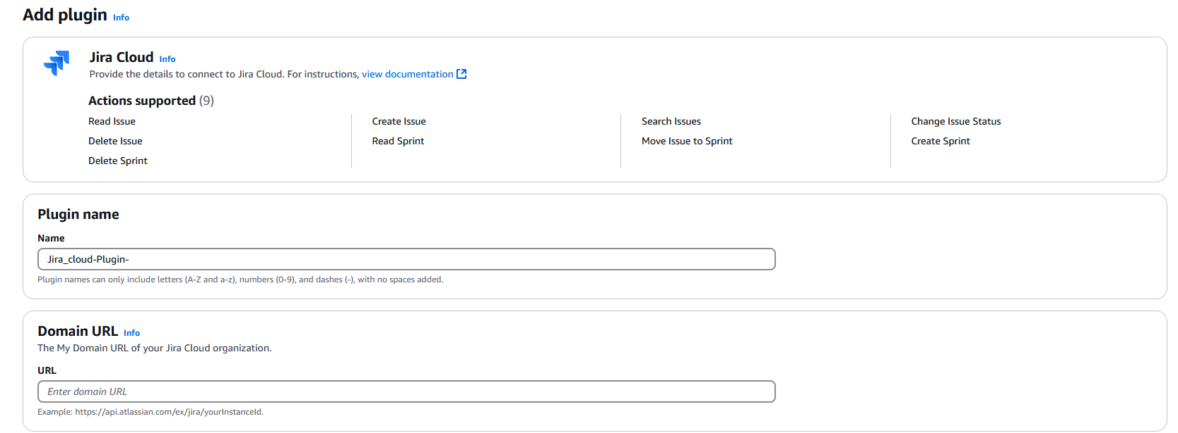
Add Jira Cloud Plugin

Slide 17
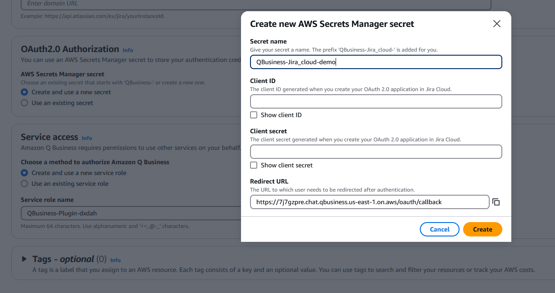
Add Jira Cloud Plugin

Slide 18
Add Jira Cloud Plugin
To obtain a Client ID and Client Secret for integrating Jira Cloud with your application:
Access Atlassian Developer Console
Create a New App
Configure App Permissions
Go to "Permissions" and select the scopes needed for your integration (e.g., read:jira-user, read:jira-work) and Save the changes.
Set Up Authorization:
Go to "Authorization".
Specify Redirect URLs that your application will use (e.g., https://yourapp.com/callback).
Save the settings.
Obtain Client ID and Client Secret:

Slide 19
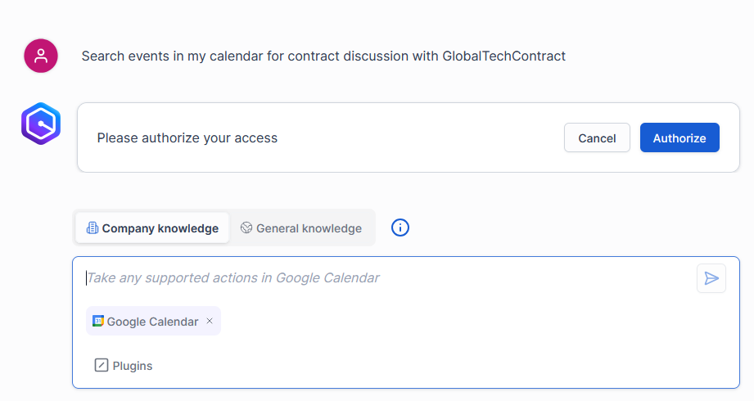
Execute Actions

Slide 20
Execute Google Calendar Action

Slide 21
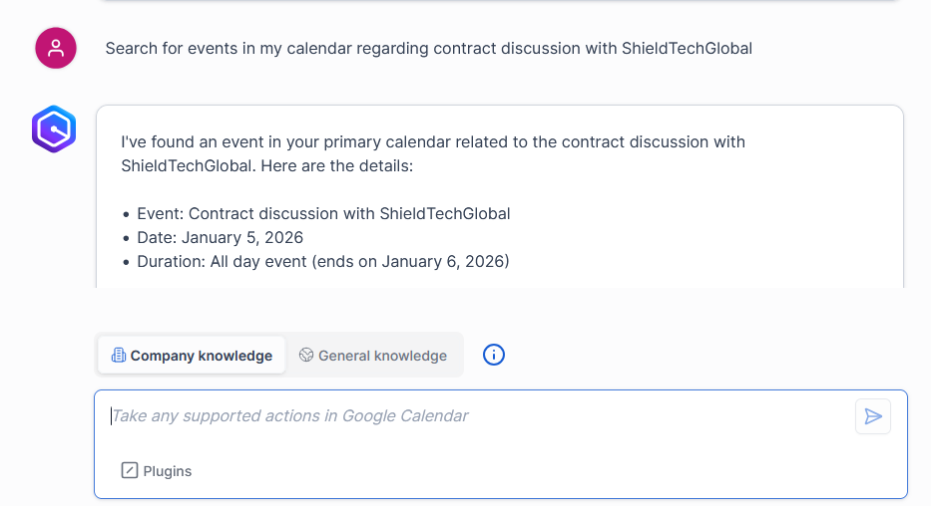
Execute Google Calendar Action

Slide 22
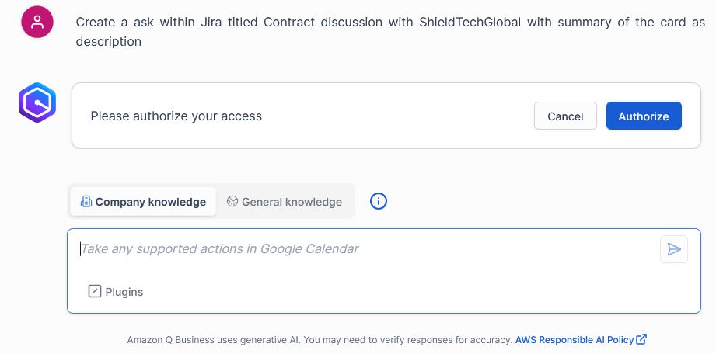
Execute Jira Cloud Action

Slide 23
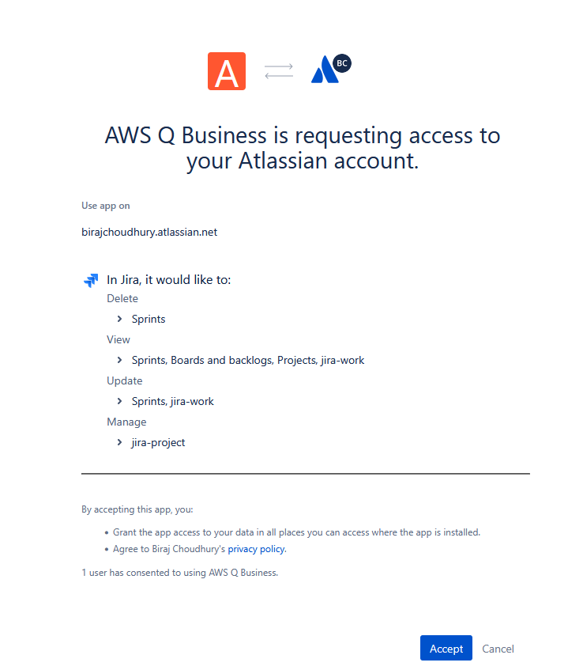
Execute Jira Cloud Action

Slide 24
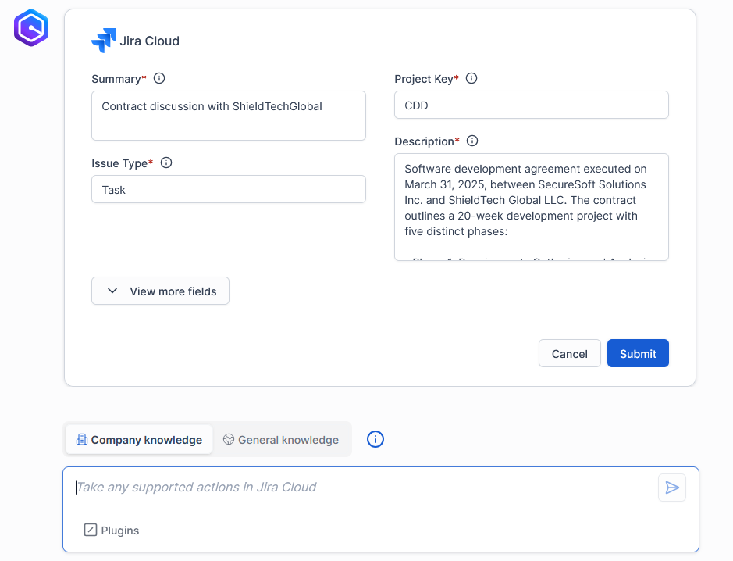
Execute Jira Cloud Action

Slide 25
Questions

Slide 26
Thank You

